Slide 1

Bank Term Deposit
---------Hackathon---------
(Press f5 to start)

Slide 2
Content
Contents of Jupyter Notebook
EDA
Performance Matrix
Conclusion

Slide 3
Contents of Jupyter Notebook
1. Pre-Processing
2. EDA
2.1. Univariate Analysis
2.2. Bivariate Analysis
2.3. Multivariate Analysis
3. Feature Engineering & Pipeline
4. Model Development
5. Result Tabulation

Slide 4
EDA
1. Most people were Contacted 1-2 times only during the campaign.
2. The duration of call ranges from 0 secs to 4918 secs(16.7 mins approx.).
3. The maximum no of days passed since some people were contacted is 871 (2 yrs aprrox.)
4. Our Target Variable has an imbalanced class distribution.

Slide 5
Based on Ratio of Yes/ No to term Deposit:
1. Students purchase Term deposits more than people who are employed .
2. People who are single purchase Term Deposit more than people who are married.
3. People with a tertiary education purchase term deposit more than people with other type of education.
4. People with a default in their record purchase term deposit more than the people with no default.
5. In March people purchase term deposit more compared to any other month of year.

Slide 6
Relationship between variables
1. As age is increasing duration of call is decreasing./ They are in a negative relationship.
2. As age is increasing the balance of people is also decreasing./ They are in a negative Relationship.
3. As Age of people is increasing the No. of times they were contacted in this campaign is decreasing. / They are in a negative relationship.
4. As Balance is decreasing the no of times people were contacted is increasing.
5. As Duration of Call is Increasing the Times people were contacted in this campaign is Decreasing.

Slide 7
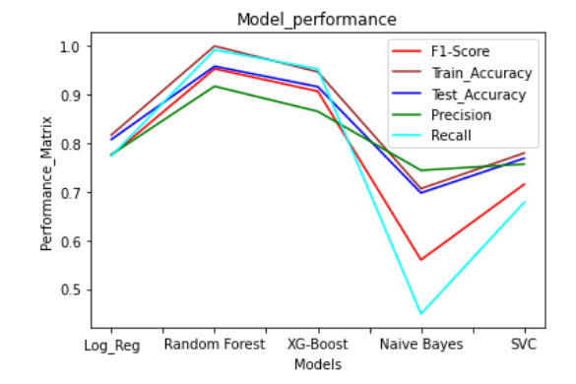
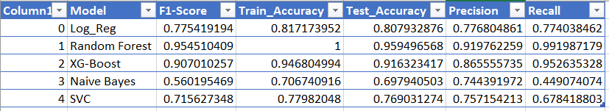
Performance Matrix
The Highest Performing Model on the data is Random Forest followed by XG-Boost.

Slide 8
Conclusion
Summary
1. The Conversation rate of campaign is highest in Month of Dec and March.
2. People With No house tend to purchase term deposit more.
3. People are showing negative response when they are getting contacted more than 10 times during a campaign.
4. For a higher call duration the chances of a person purchasing Term Deposit is higher.
Suggestions
1. Connect with people more in the month of March and Dec these 2 months are showing a higher chance of people purchasing Term Deposit.
2. People with no house are saving there money through term deposits so we can have some attractions for them and try contacting such people more.
3. There is no use of contacting a person more than 10 times as beyond this point the chance of yes to term deposit is close to 0.
4. There are higher chances of yes to term deposit when call durations are long so we can work on improving our
communication and convincing powers

Slide 9
END OF SLIDES

